Slide 1
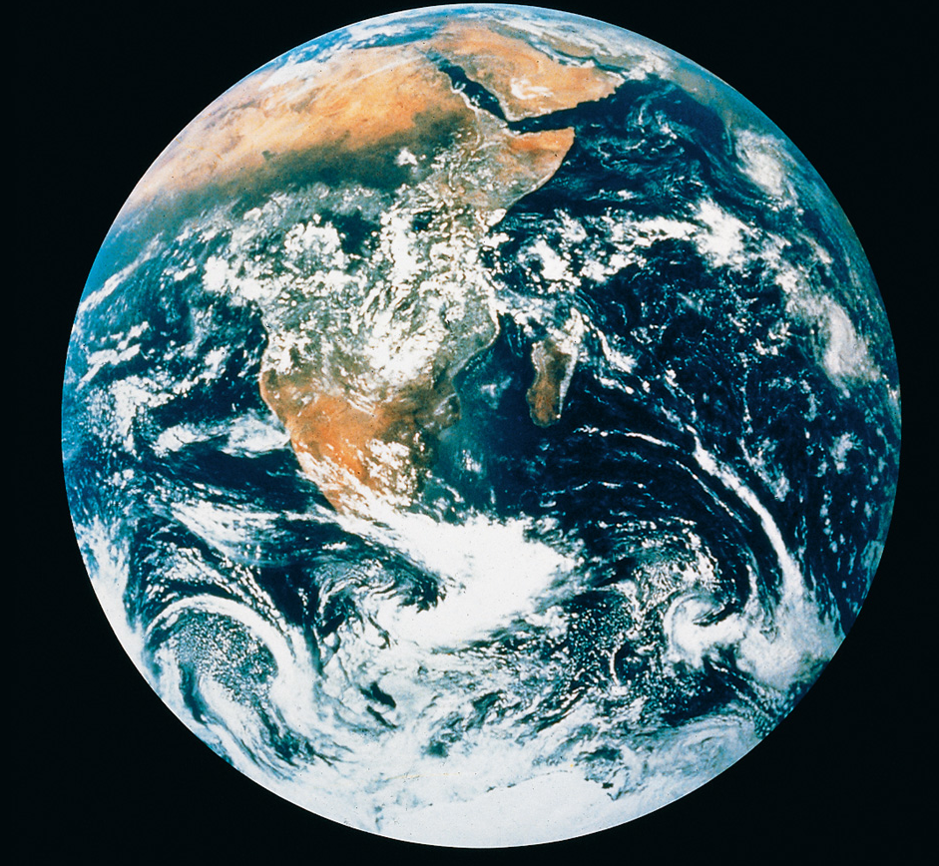
WELCOME TO
EARTH SCIENCE CLASS!
SPRING 2021
In this course we will explore our precious home planet, Earth,
and some of our neighbors in the solar system.

Slide 2
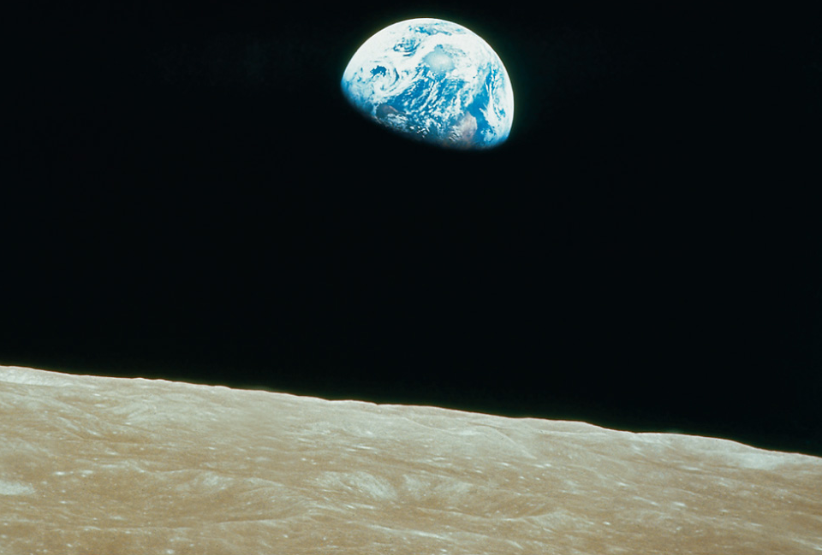
CHAPTER 1
INTRODUCTION TO
EARTH SCIENCE
Earth Science is the study of Earth and its neighbors in space.

Slide 3
Why Study Earth Science?
We live in a time when planet Earth and its inhabitants face many challenges. Our climate is changing, and some of that change is being caused by human activity. Earth scientists recognize this problem and will play a key role in efforts to resolve it. We are also challenged to develop new sources of energy that will have minimal impact on the climate, locate new sources of metals and other mineral resources as known sources are depleted, and determine how Earth's increasing population can live and avoid serious threats such as volcanic activity, earthquakes, landslides, floods and more. These are just a few of the problems where solutions depend upon a deep understanding of Earth Science.

Slide 4
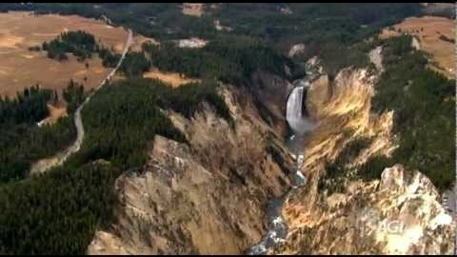
Why Study Earth Science?
Watch this inspiring video produced by the American Geological Institute (AGI). The video emphasizes the importance of an Earth Science education and the need for Geoscientists .

Slide 5

Watch this video on: Careers in Earth and Space Sciences

Slide 6
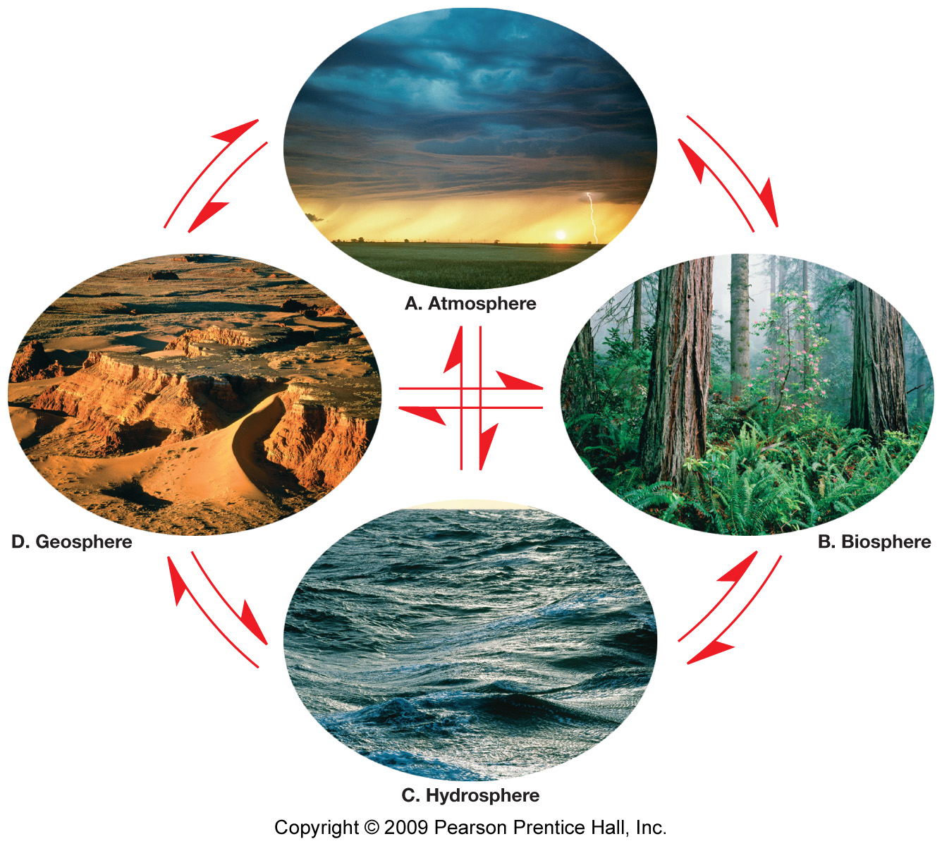
Earth is a dynamic body with many separate
but highly interacting parts or spheres.
}
Earth Consists Of 4 Major Spheres:
Geosphere
Hydrosphere
Atmosphere
Biosphere
Earth’s
Physical
Environment
Click on diagram to watch the video: “4 Spheres of the Earth”

Slide 7
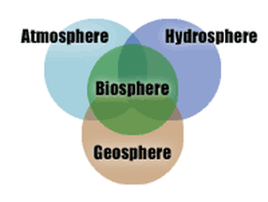
Earth’s Interacting Spheres
Earth is a complex and dynamic set of interconnected
spheres—mainly the geosphere, hydrosphere, atmosphere, and biosphere. All of Earth’s processes are the result of energy flowing and matter cycling within and among these spheres. For example, the motion of tectonic plates is part of the cycle of convection in Earth’s mantle, driven by outflowing heat and the downward pull of gravity, which result in the formation and changes of many features of Earth’s land and undersea surface. Weather and climate are shaped by complex interactions involving sunlight, the ocean, the atmosphere, clouds, ice, land, and life forms. Earth’s biosphere has changed the makeup of the geosphere, hydrosphere, and atmosphere over geological time; conversely, geological events and conditions have influenced the evolution of life on the planet. Water is essential to the dynamics of most Earth systems, and it plays a significant role in shaping Earth’s landscape.

Slide 8

Earth Science includes all the sciences that seek to understand Earth and its neighbors in space.
Geology - Study of the solid Earth
Oceanography - Study of the oceans
Meteorology - Study of the atmosphere and
the processes that produce weather and climate
Astronomy - Study of the Universe

Slide 9
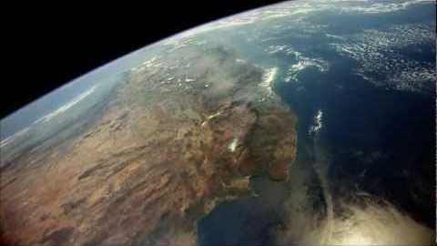
Click on the Earth’s photo to watch an awesome and inspiring video: “Introduction To Earth Science”

Slide 10

SOME BASIC FACTS ABOUT EARTH
* SIZE – Diameter (Approx.) = 12,800 km
(≈ 8,000 miles)
* MASS = 6.0 x 10²⁴ kg
* DENSITY - At Surface, avg = 3,000 kg/m³
At Core, avg = 12,000 kg/m³
* Overall Average = 5,520 kg/m³
Why is the core’s density so much greater than the density
at the surface?
Find out when we study Earth’s interior in Chapter 5.

Slide 11

Highly Recommend This Video: “Earth is Calling”

Slide 12

I will post Chapter 2 power point slides and your
first assignment on Blackboard next class.
I am looking forward to working with all of you this
semester as we learn about our amazing and special
planet, Earth!
Wishing you a successful semester!
“We are all connected. To each other, biologically. To the earth, chemically. To the rest of the universe, atomically.”
Neil deGrasse Tyson
“Like music and art, love of nature is a common language that can transcend political or social boundaries.”
—Jimmy Carter

